Slide 1
5G NR Transmitter Conformance Testing
R&S Thirty-Five: 5G NR Base station conformance testing
KS 5G NR gNB Transmitter Conformance Testing Basics

Slide 2
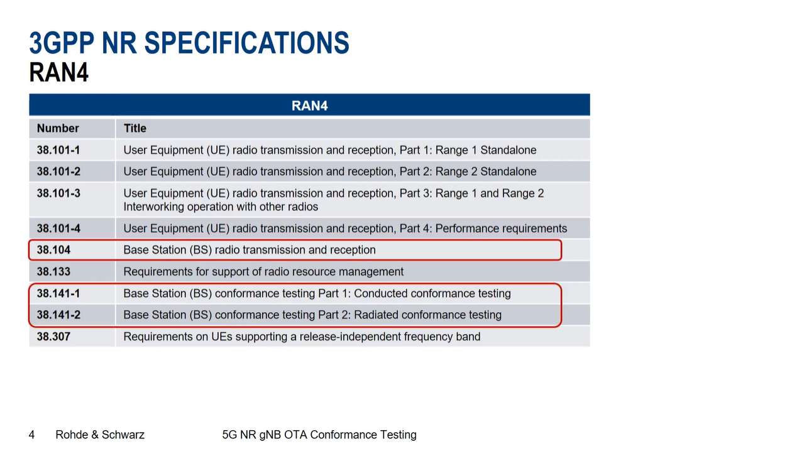

Slide 3
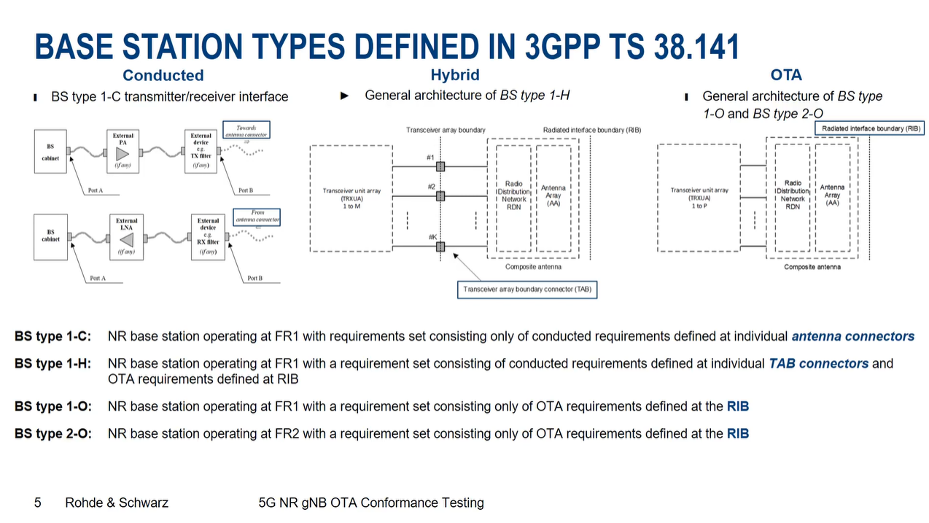

Slide 4
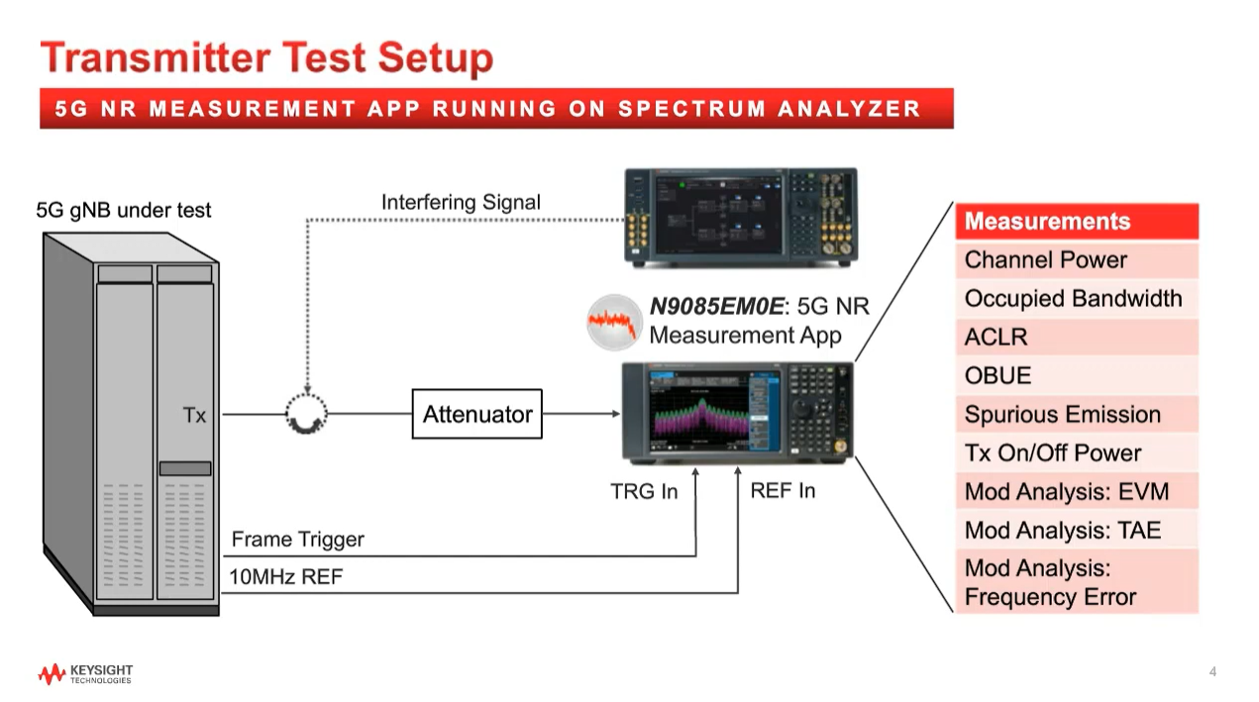

Slide 5
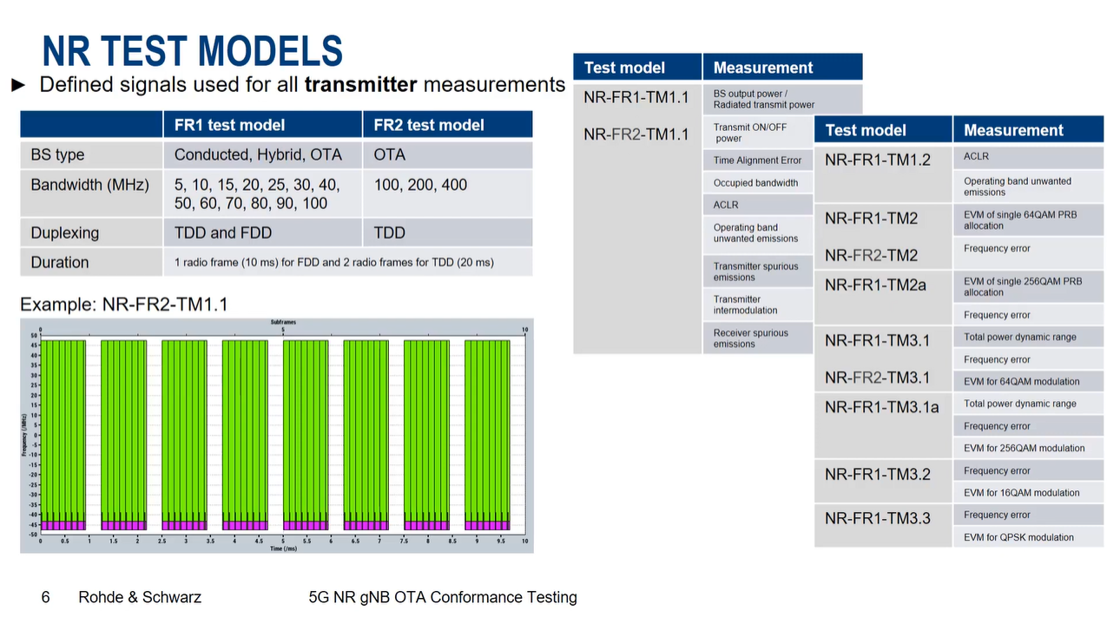

Slide 6
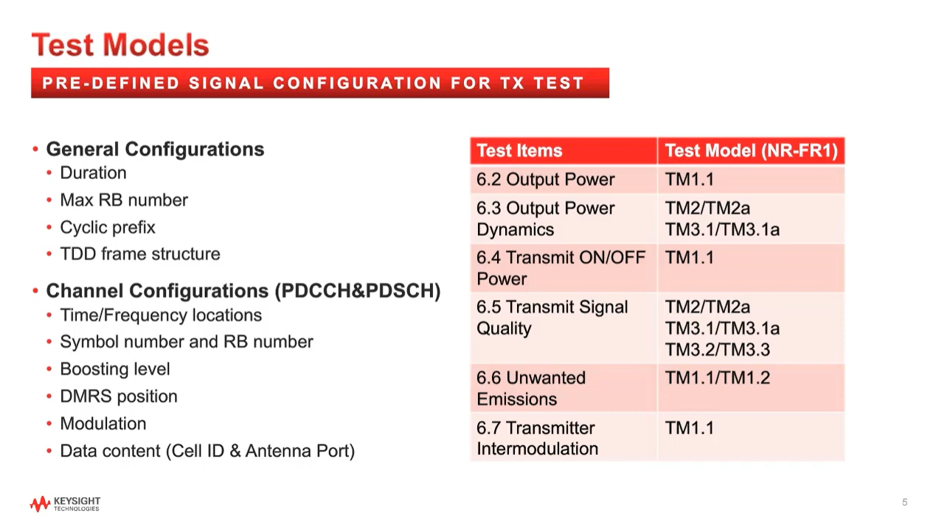

Slide 7
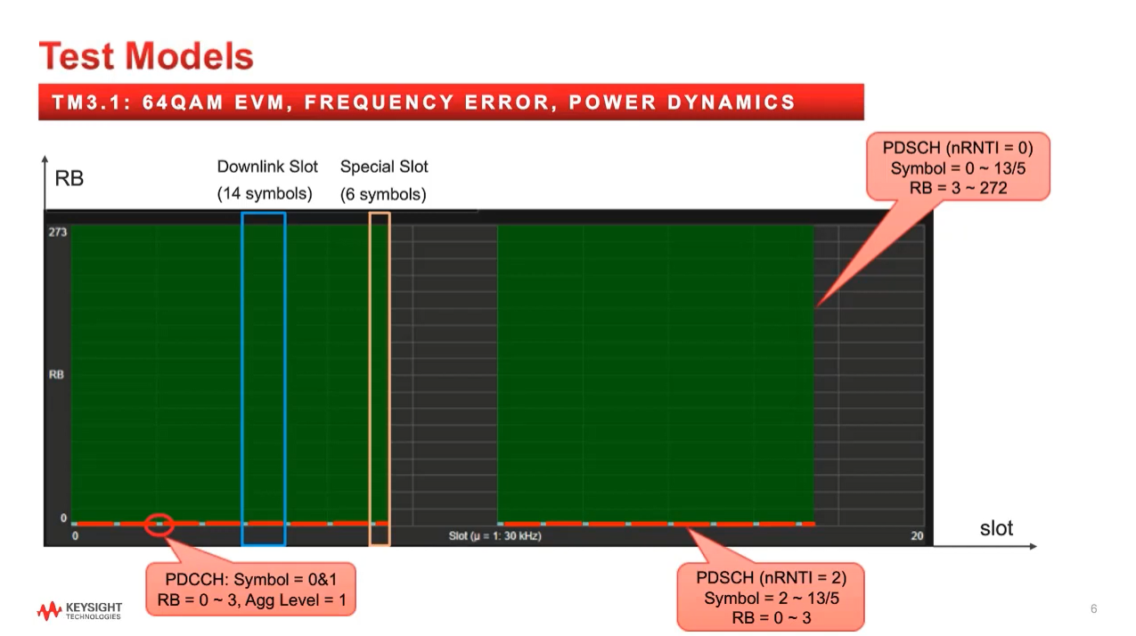

Slide 8
